Slide 1

Project Title –Netflix Dataset Analysis
[Gnanaprasuna ]
[APPLY_175623028868adf2901f2 ]
Internship ID: INTERNSHIP_17546440516895be537820f

Slide 2

PROBLEM STATEMENT
Netflix, as a global streaming service, faces the challenge of optimizing its massive content library to maximize subscriber acquisition, retention, and engagement in a highly competitive market. To make informed, strategic investments in content (whether through acquisition or original production), the company must understand how its content mix has evolved over time and where key opportunities or gaps exist in terms of content type, genre, and geographic origin.

Slide 3
Project Description This project involves an Exploratory Data Analysis (EDA) of the Netflix content catalog. The analysis focuses on quantifying historical trends in content addition, specifically the volume balance of Movies versus TV Shows over time. We identify and visualize the dominant genres and map the geographic contributions of key countries like the US, India, and the UK. The primary goal is to derive actionable, data-driven recommendations to guide future strategic investment in content acquisition and original production. The final output provides insights into potential content gaps and high-growth areas.

Slide 4

WHO ARE THE END USERS?
Content Strategy Executives (C-Suite/VPs)
Content Acquisition Managers
Regional Content Leaders
Data Science/BI Teams
Marketing Teams

Slide 5

Technology Used
Python
Pandas
Matplotlib
Seaborn
Collecton.Counter

Slide 6
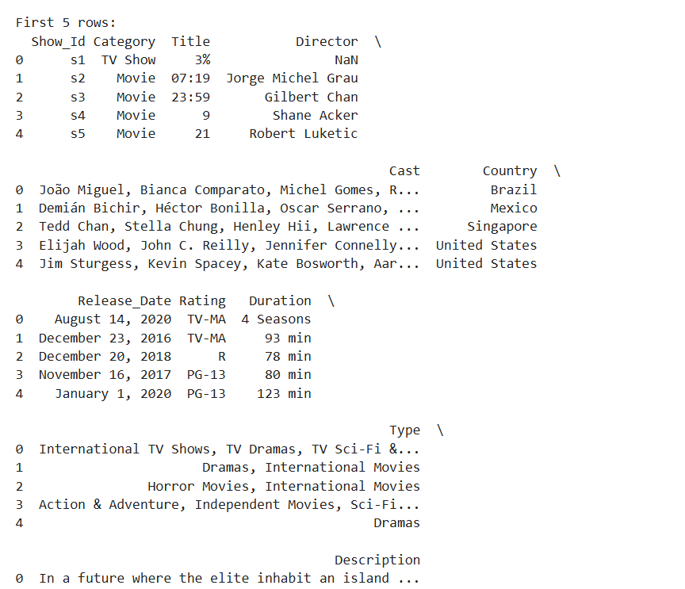
RESULTS1
[Add screen shots of your code or Chart(s) ]

Slide 7
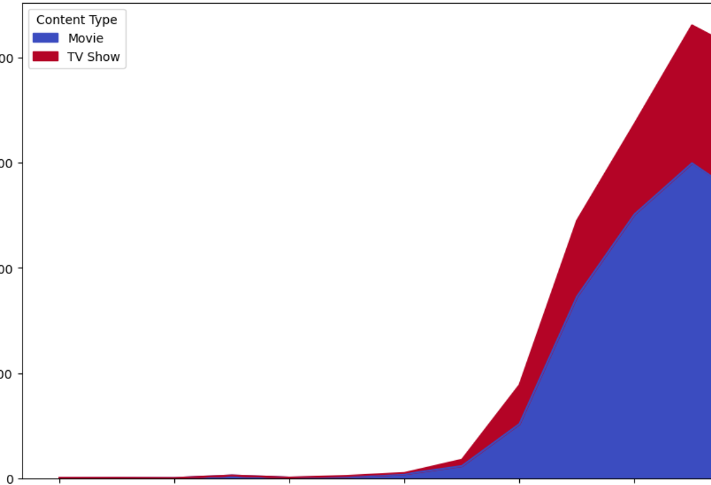
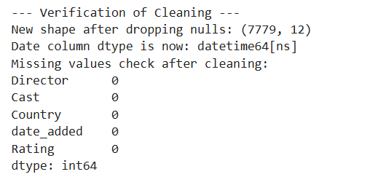
RESULTS2
[Add screen shots of your code or Chart(s) ]

Slide 8
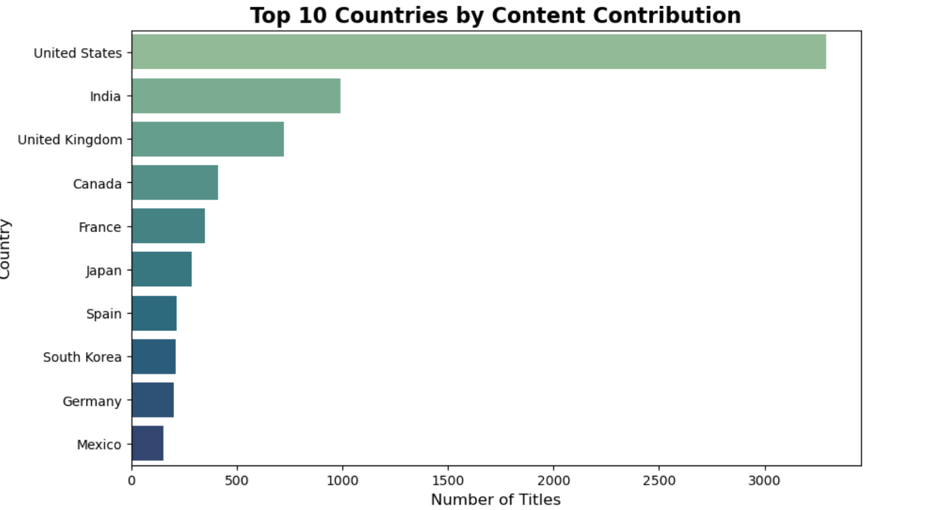
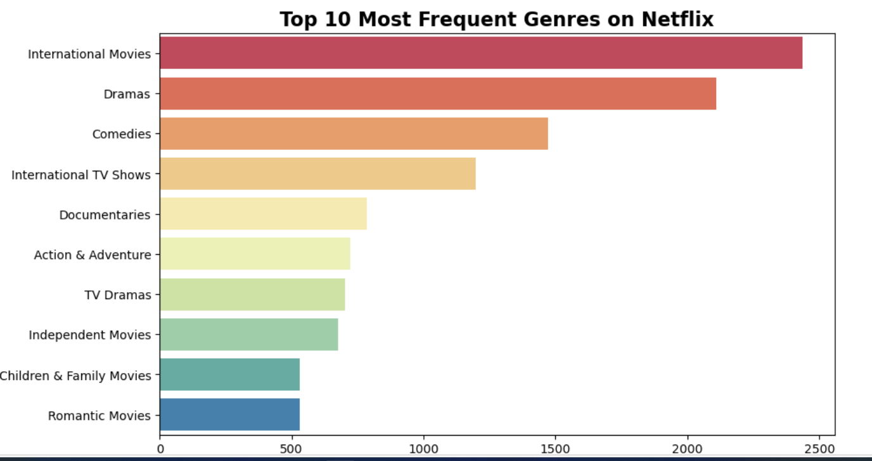
RESULTS3
[Add screen shots of your code or Chart(s) ]

Slide 9
GitHub repository
[https://github.com/bindu2220/VOIS_AICTE_Oct2025_MajorProject_GnanaprasunaPutta.git]

Slide 10



Getting started with Basics of Python Certificate
[Paste your Certificate Here]
Gnanaprasuna Putta
Getting started with Basics of Python
Data Visualization
October 7, 2025
September 23, 2025
VFLMS25_145669

Slide 11
Data Visualization Certificate
[Paste your Certificate Here]
Gnanaprasuna Putta
Data Visualization
October 7, 2025
VFLMS25_145669

Slide 12
Thank you
.
.

